Slide 1
Population Methods

Slide 2
Population Methods
Instead of optimizing a single design point, population methods optimize a collection of individuals
A large number of individuals prevents algorithm from being stuck in a local minimum
Useful information can be shared between individuals
Stochastic in nature
Easy to parallelize

Slide 3
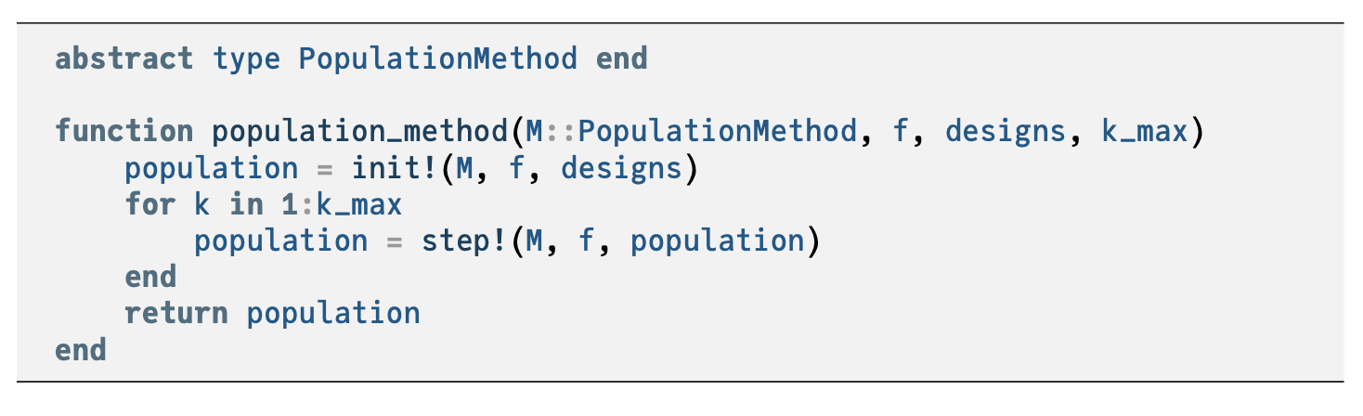



Slide 4





Initialization
Population methods begin with an initial population
Common initializations are uniform, normal distribution, and Cauchy distribution

Slide 5
Genetic Algorithms
Inspired by biological evolution where the fittest individuals pass their genetic information to the next generation
Individuals are interpreted as chromosomes
The fittest individuals are determined by selection
The next generation is formed by selecting the fittest individuals and performing crossover and mutation

Slide 6
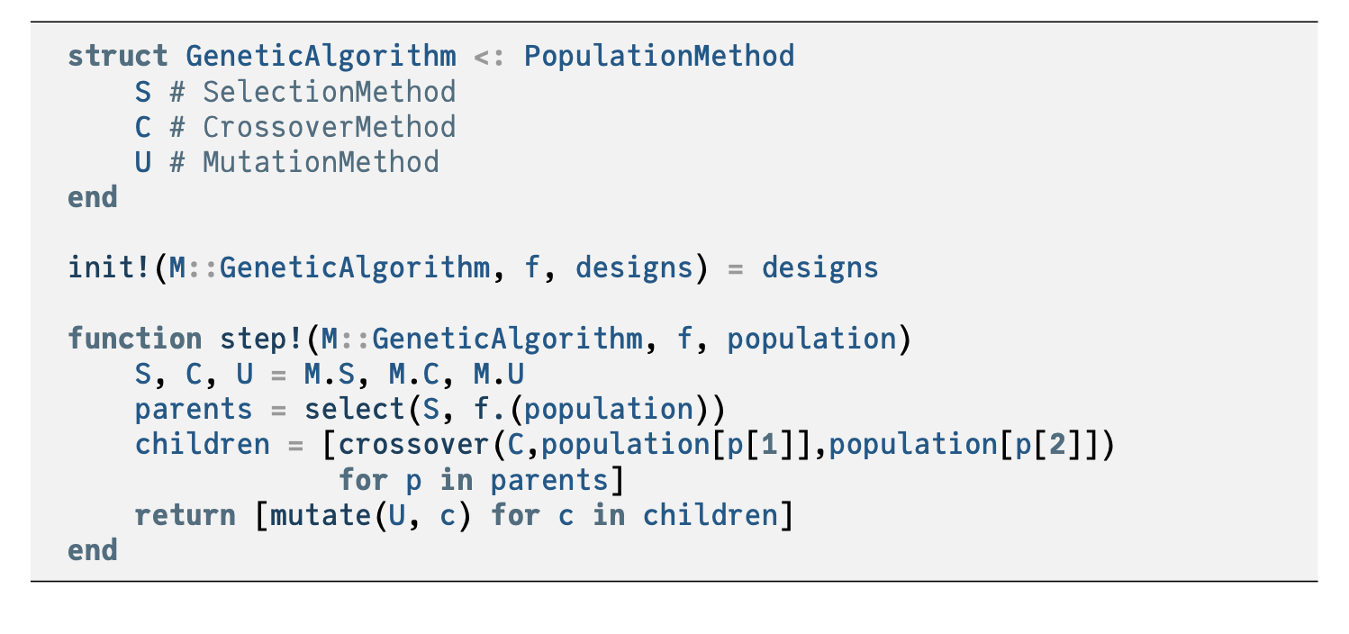




Slide 7

Genetic Algorithms: Selection
Determining which individuals pass their genetic information on to the next generation
Truncation selection: truncate the lowest performers
Tournament selection: selects fittest out of k randomly chosen individuals
Roulette Wheel selection: individuals are chosen with probability proportional to their fitness

Slide 8
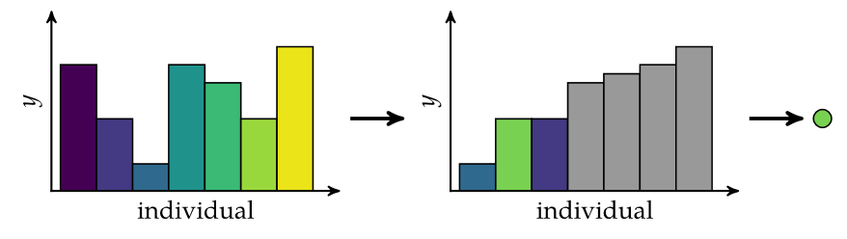
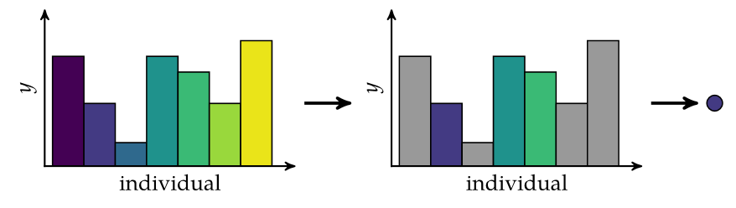
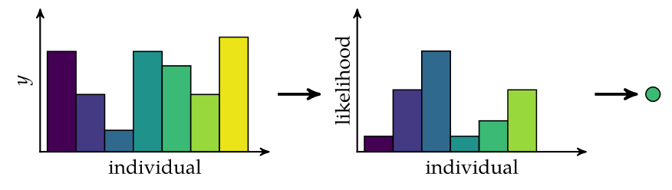










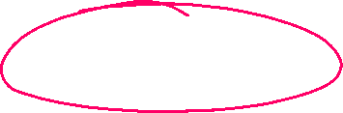












Genetic Algorithms: Selection
Truncation Selection
Tournament Selection
Roulette Wheel Selection

Slide 9
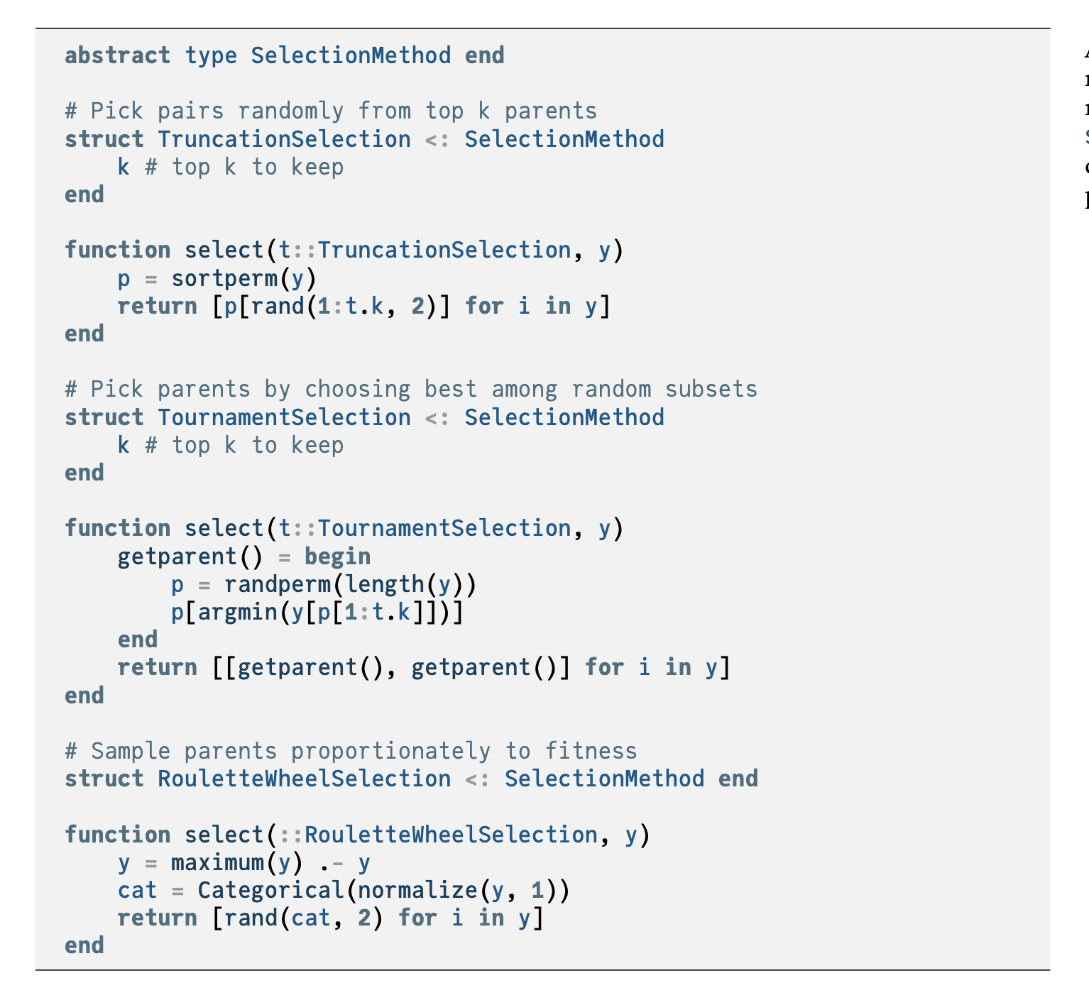


Slide 10

Genetic Algorithms: Chromosomes
Simplest representation is the binary string chromosome
Chromosomes are more commonly represented as real-valued chromosomes which are simply real-valued vectors
Typically initialized randomly

Slide 11
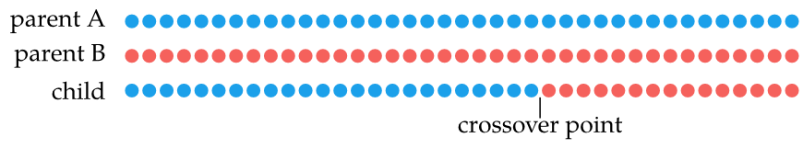
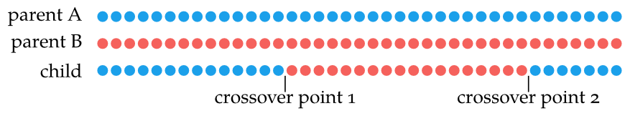
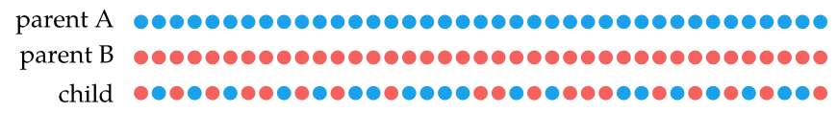
Genetic Algorithms: Crossover
Combines the chromosomes of the parents to form children
Single-point crossover: swap occurs after single crossover point
Two-point crossover: two crossover points
Uniform crossover: each bit has 50% chance of crossover

Slide 12
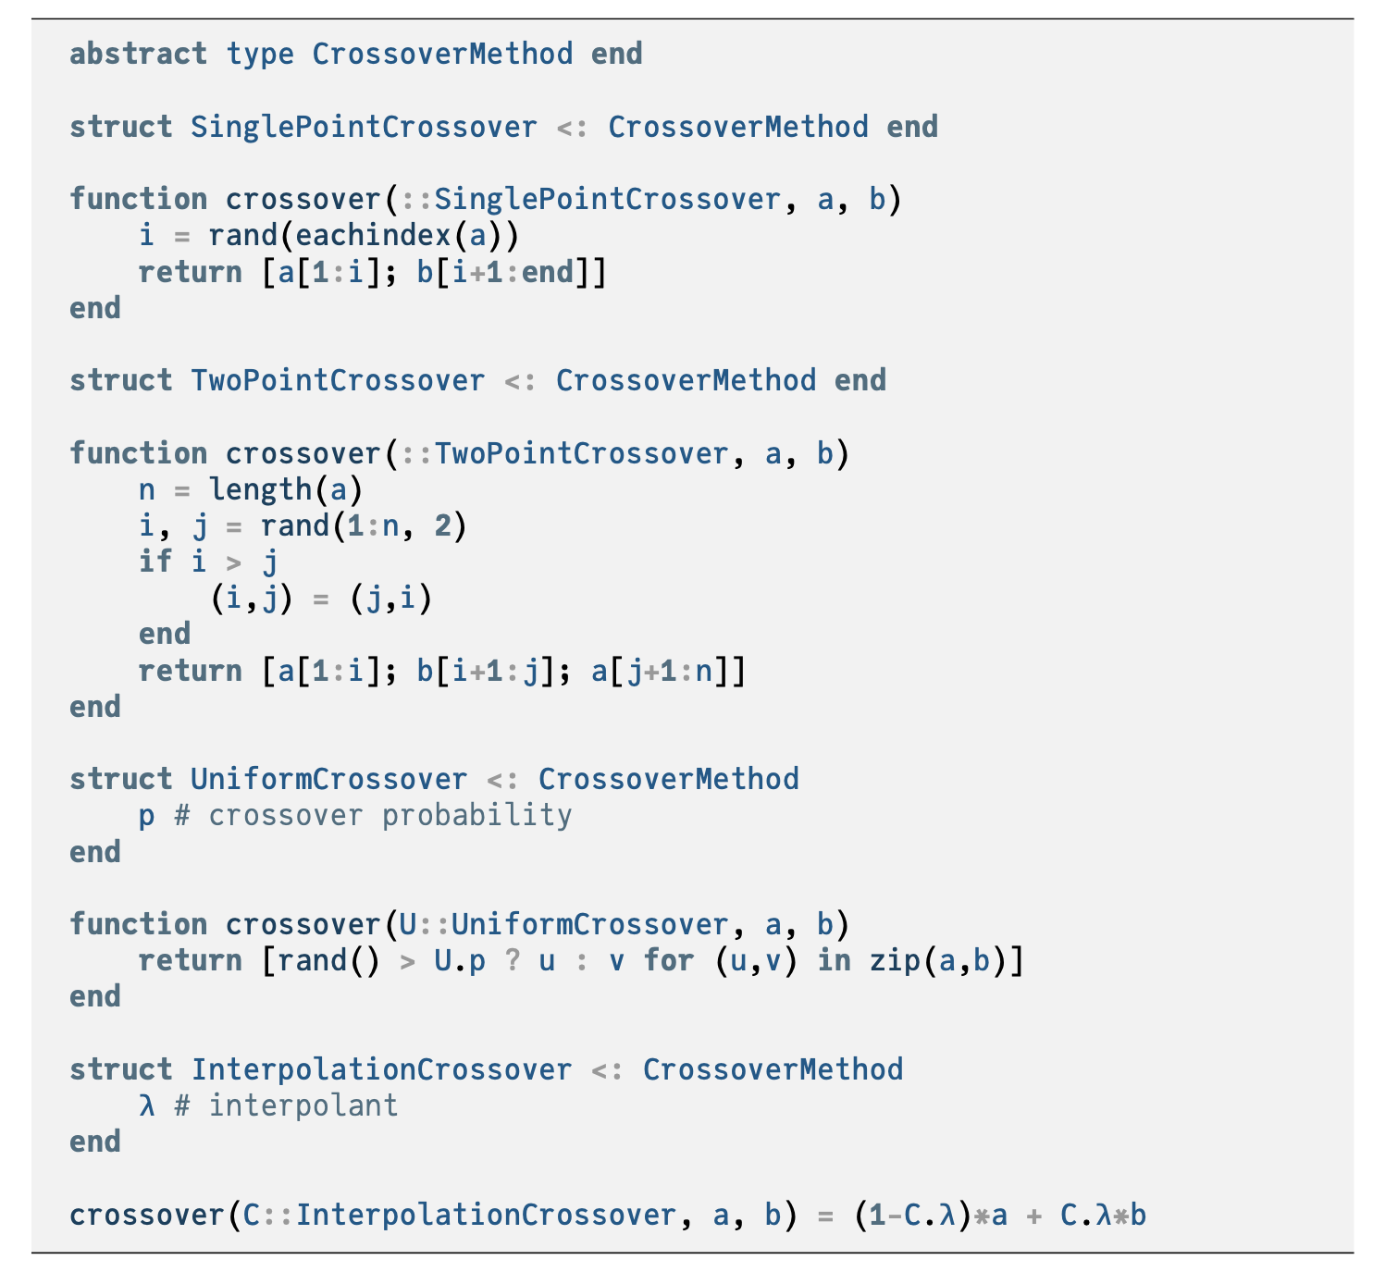

Slide 13
Genetic Algorithms: Mutation
Mutation supports exploration of new areas of design space
Each bit or real-valued element can has a probability of being flipped or modified by noise
The probability of an element mutating is called mutation rate

Slide 14
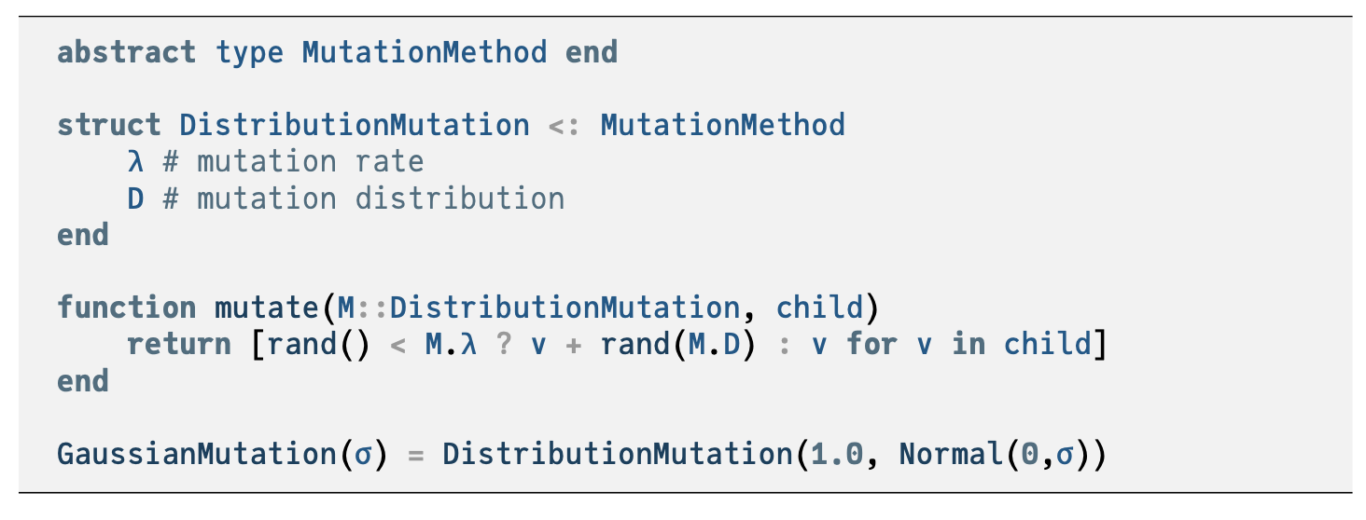

Slide 15
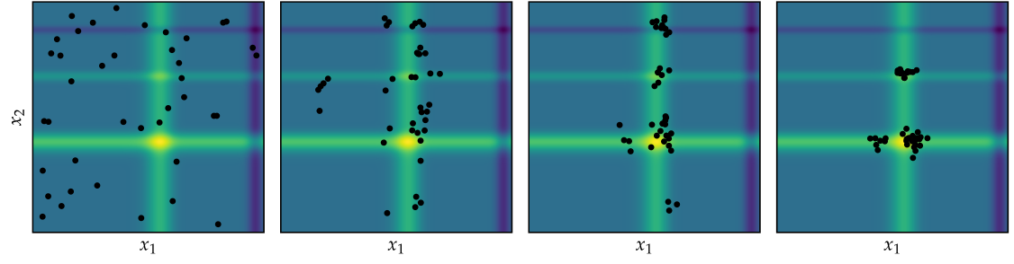
Genetic Algorithms
Genetic algorithm with truncation selection, single point crossover, and Gaussian mutation applied to Michalewicz function

Slide 16
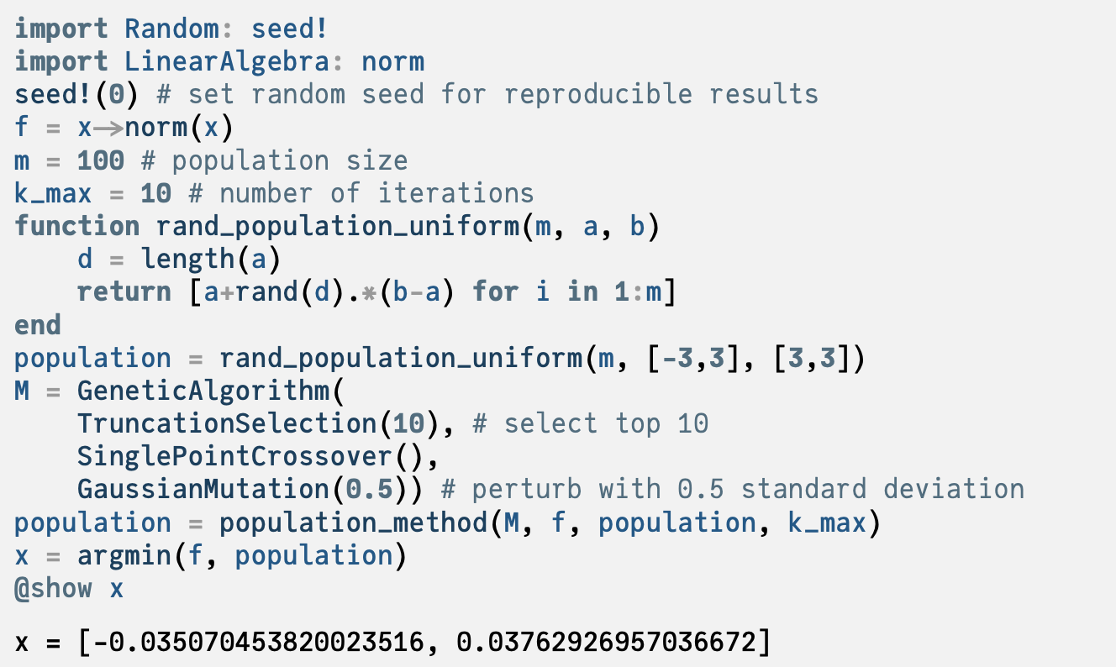

Slide 17
Differential Evolution
Improves each individual x by recombining other individuals according to a simple formula
Choose three random, distinct individuals a, b, and c
Construct interim design z = a + w(b - c)
Choose a random dimension to optimize in
Construct candidate x’ via binary crossover of x and z
Insert better design between x and x’ into next generation

Slide 18
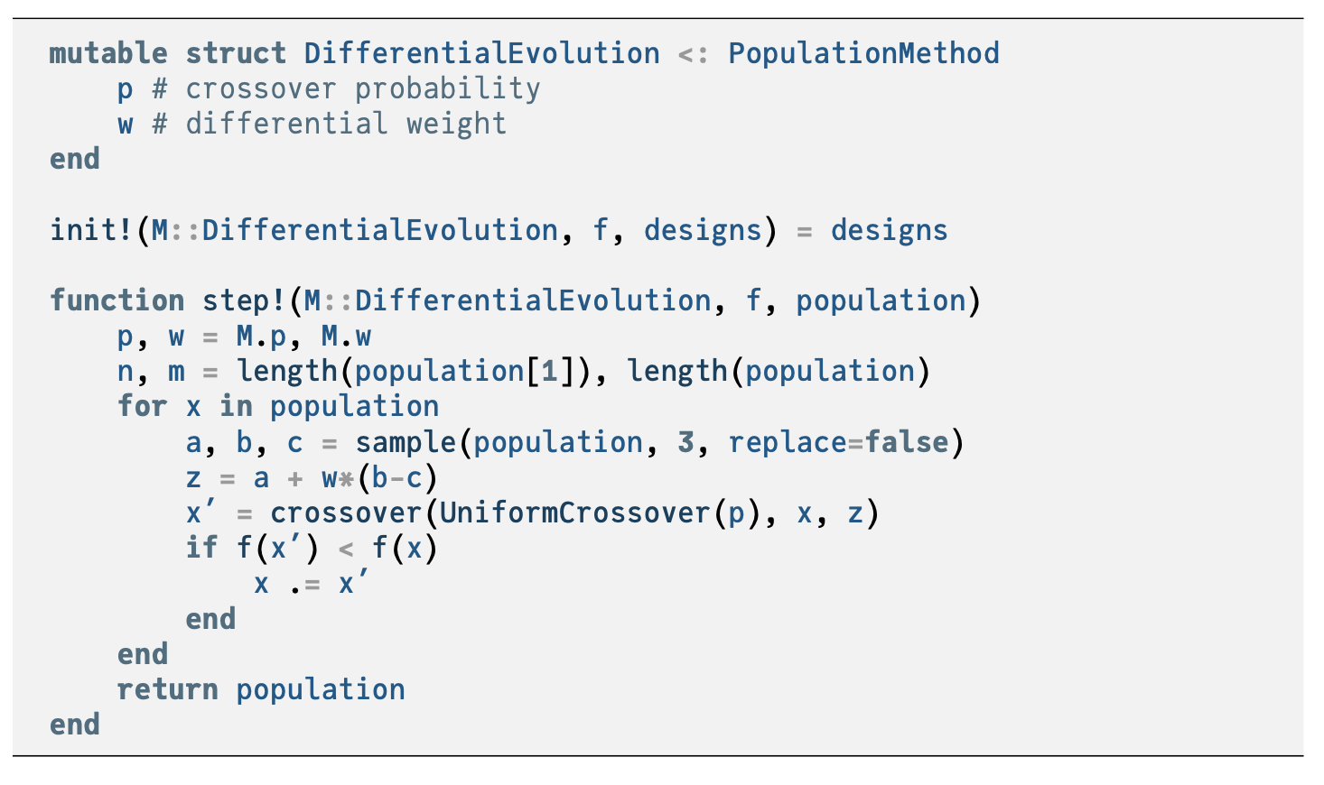

Slide 19
Differential Evolution

Slide 20

Particle Swarm Optimization
Each individual, or particle, tracks the following
Current position
Current velocity
Best position seen so far by the particle
Best position seen so far by any particle
At each iteration, these factors produce “force” and “momentum” effects to determine each particle’s movement

Slide 21
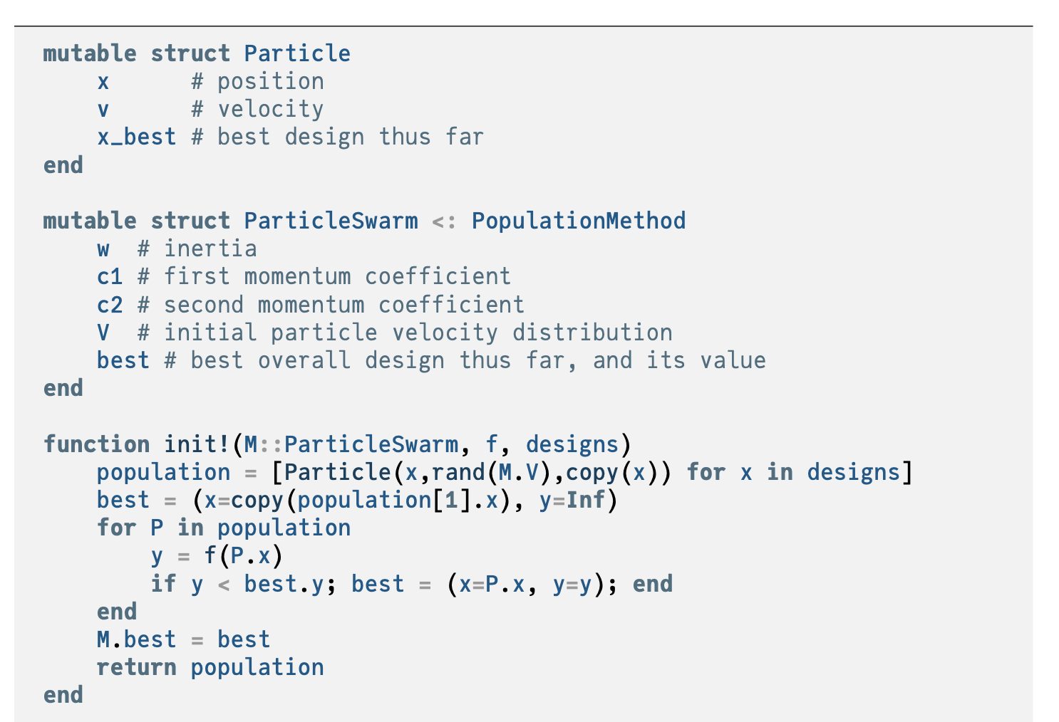

Slide 22
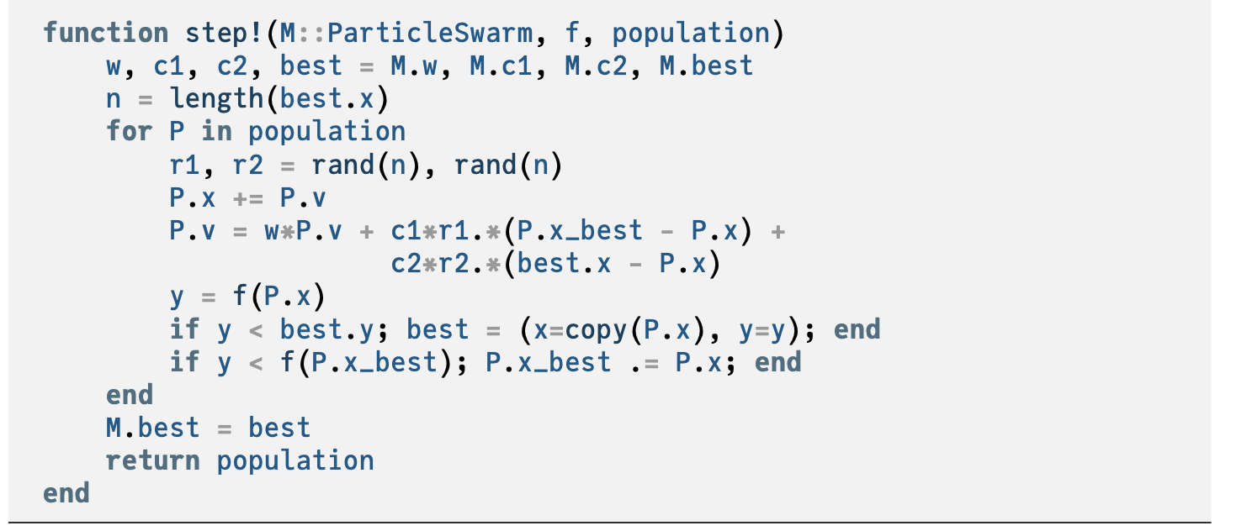

Slide 23
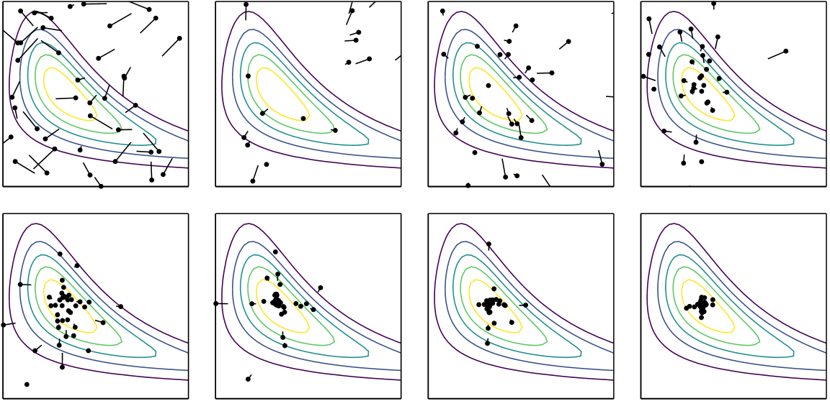
Particle Swarm Optimization

Slide 24
Hybrid Methods
Generally, population methods are good at finding the best regions in design space, but do not perform as well as descent methods near the minimizer
Hybrid methods try to leverage the strength of both methods
Two hybrid approaches
Lamarckian learning
Baldwinian learning

Slide 25
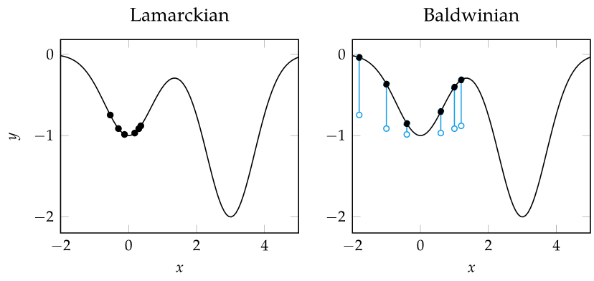
Hybrid Methods
Lamarckian learning
Performs regular descent method update on each individual
Baldwinian learning
Uses value of descent method update to augment the objective value of each design point

Slide 26
Summary
Population methods use a collection of individuals in the design space to guide progression toward an optimum
Genetic algorithms leverage selection, crossover, and mutations to produce better subsequent generations
Differential evolution, particle swarm optimization, the firefly algorithm, and cuckoo search include rules and mechanisms for attracting design points to the best individuals in the population while maintaining suitable state space exploration
Population methods can be extended with local search approaches to improve convergence

